Slide 1
CS4042 – Information Processing Techniques(IPT)
Week – 02
Sep 13-17, 2021
Instructor: Basit Ali

Slide 2
ASP.Net (Active Server Pages)
ASP | ASP.NET
ASP is the interpreted languages ASP is partially object oriented. ASP doesn’t have the concept of inheritance. ASP is a technology (much like PHP) for executing scripts on a web server. | ASP.NET is the compiled language. ASP.NET is fully object oriented. ASP.NET inherit the class written in code behind. Designed for the generation of dynamic web pages.

Slide 3
ASP.NET Architecture
VB
C++
C#
JScript
…
Common Language Specification
ASP.NET: Web Services
and Web Forms
Windows Forms
Visual Studio.NET
ADO.NET: Data and XML
Base Classes
Common Language Runtime
Notes:
1- ASP.Net code can be used with C# or even VB.Net
ASP.NET is built upon
.NET Framework
Internet Information Server (IIS)

Slide 4
Static & Dynamic Web Pages
In static web pages, Pages will remain same until someone changes it manually. Static web pages are written in languages such as: HTML, JavaScript, CSS, etc Static web pages does not contain any application program . | In dynamic web pages, Content of pages are different for different visitors Dynamic web pages are written in languages such as: CGI, AJAX, ASP, ASP.NET, etc.. Dynamic web pages contains application program for different services.

Slide 5
Full PostBack & Partial PostBack
Partial postbacks iterate through the same page lifecycle as a synchronous full page postback, but only specific regions or controls on the page are refreshed - thus achieving partial page rendering

Slide 6
Server-Side Code
What is server-side code?
Software that runs on the server, not the client
Receives input from
URL parameters
HTML form data
Can access server-side databases, e-mail servers, files, mainframes, etc.
Dynamically builds a custom HTML response for a client
HTTP request
(form data,
HTTP header data)
HTTP response HTML, XML
ASP page
(static HTML, server-side
logic)

Slide 7
Web Development
Which language(s) is/are understood by the browser?
HTML
JavaScript
CSS
What is the purpose of Server-Side Languages like ASP.Net, PHP, JSP, etc
What is meant by the terms “POST” and “GET”
GET has parameters in URL (Query String)
POST has parameters in the message header
Notes:
1- Ask students what are the things that the browser understands, once they have answered, clarify that only these 3 things are rendered.
2- JavaScript/Angular are client side languages, so what does ASP.Net/ PHP/ JSP do? Explain Static v/s dynamic websites and then transition into server-side explanation using an example request.
3- Ask about POST and GET. If they don’t recall, remind them html form tag and then explain that GET has its limitation of either 256 variables or size defined by the browser (can be 10MB of query string) where POST does not have such issues.

Slide 8
MVC
MVC stands for Model, View, and Controller. MVC separates an application into three components - Model, View, and Controller.

Slide 9
MVC : Model
Model represents the shape of the data. A class in C# is used to describe a model. Model objects store data retrieved from the database.
Model represents the data.

Slide 10
MVC : View
View in MVC is a user interface. View display model data to the user and also enables them to modify them. View in ASP.NET MVC is HTML, CSS, and some special syntax (Razor syntax) that makes it easy to communicate with the model and the controller.
View is the User Interface

Slide 11
MVC : Controller
The controller handles the user request. Typically, the user uses the view and raises an HTTP request, which will be handled by the controller. The controller processes the request and returns the appropriate view as a response.
Controller is the request handler.

Slide 12
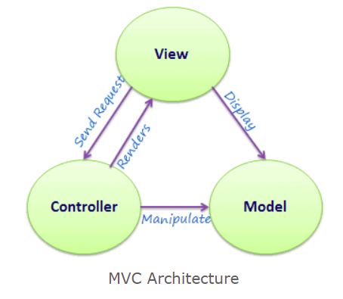
MVC Architecture

Slide 13
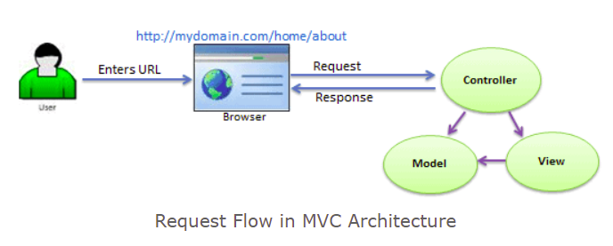
Illustration of Flow in MVC

Slide 14
DevOps

Slide 15
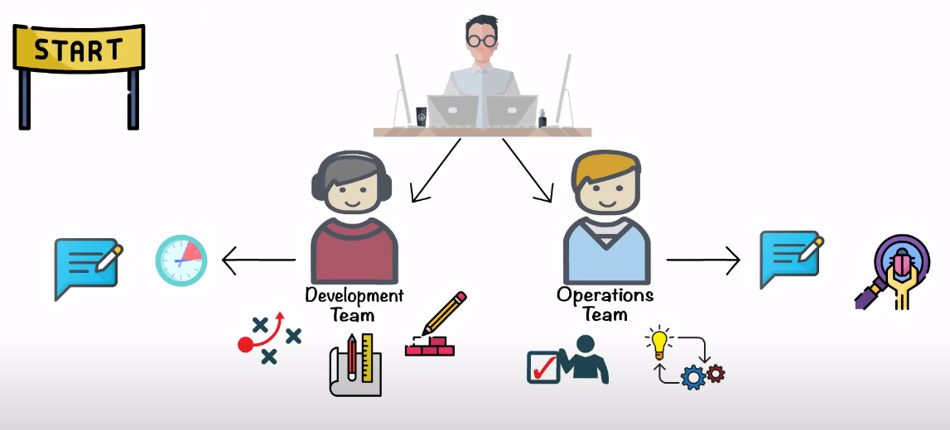
Software Development Life-Cycle
Notes:
Development Team:
Plan
Design
Build
Operation Team:
Testing
Implementation
D->O = Waiting for feedback from the operation team
O->D = Feedback about bugs

Slide 16
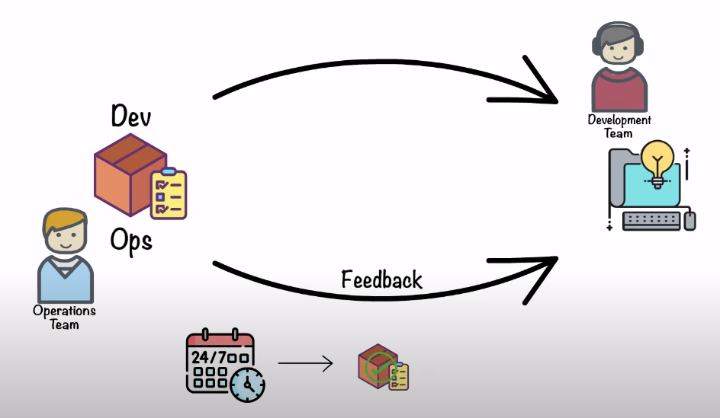
Problem

Slide 17
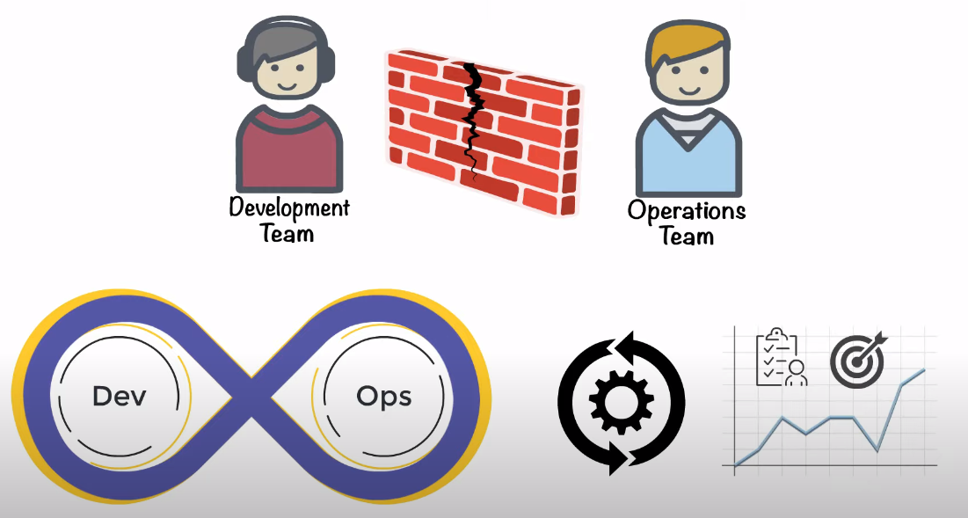
Solution : DevOps

Slide 18
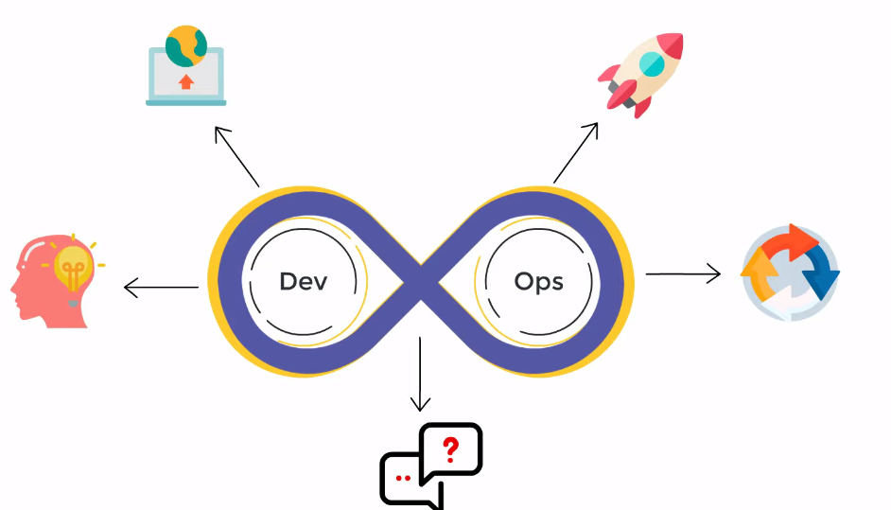
DevOps

Slide 19
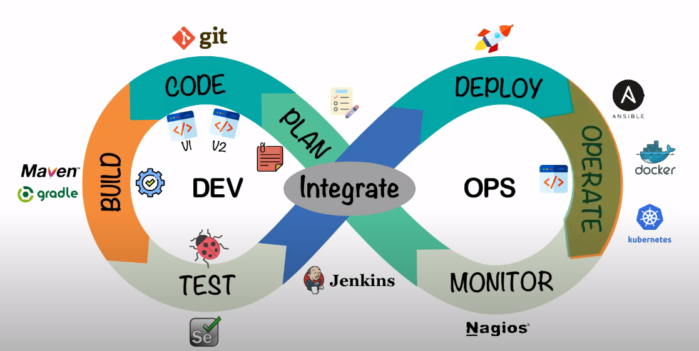
DevOps Phases

